Slide 1

Linux
KAPASA MAKASA UNIVERSITY
School of Applied Sciences and Education
ICT Department
Operating System Security (CYS337)
Bypassing Login Page
James Soko (20231392)

Slide 2
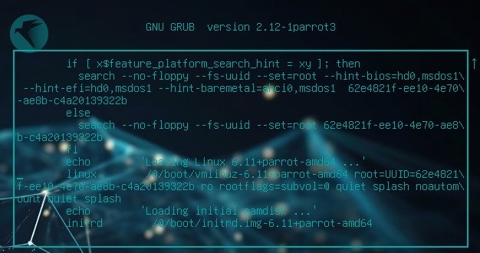
EDIT MODE
Restart your machine and press Esc or Shift during reboot.
Press E on your keyword.

Slide 3
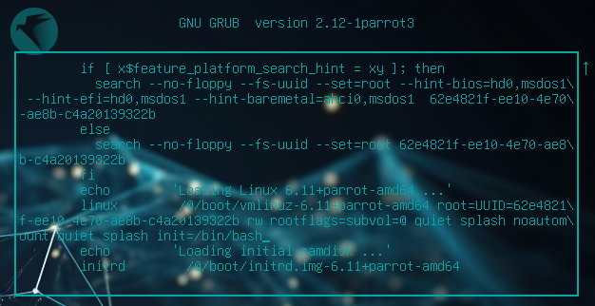
EDIT MODE
Change ro to rw (Read and Write) and add init=/bin/bash or single at the end

Slide 4
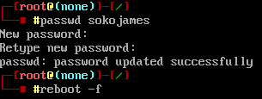
CHANGE USER PASSWORD
Press Ctrl + X or F10 to boot.
Press Enter

